Slide 1
APPLICATIONS OF ENVIRONMENTAL BIOTECHNOLOGY
By
Dr. Zaryab Khalid
Class MS Botany
Subject Environmental biotechnology
Semester II

Slide 2
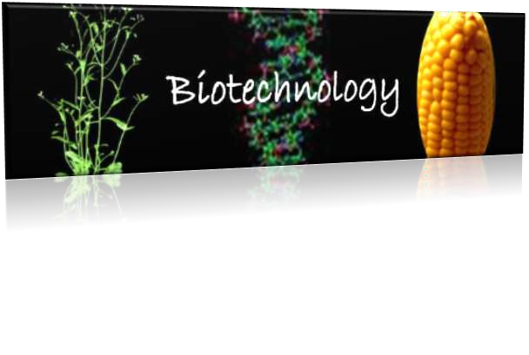
INTRODUCTION TO ENVIRONMENTAL BIOTECHNOLOGY?
According to the international Society for environmental Biotechnology the environmental Biotechnology is defined as an environment that helps to develop, efficiently use and regulate the biological systems and prevent the environment from pollution or from contamination of land, air and water have work efficiently to sustain an environment friendly Society.

Slide 3

Environmental Biotechnology is Biotechnology that is applied to and use to study to natural environment.
Environmental Biotechnology can simply be described as “the optimal use of nature in the form of Plants, animals, bacteria, fungi, algae, to produce renewable energy, food and nutrients in a synergistic integrated cycle of profit making processes where the west of each process becomes the feedstock for another process.

Slide 4

Environmental Biotechnology needed to:
eliminate the hazardous wastes produced by our other technologies.
distinguish between similar species and ensure species are not at risk of extinction.
create alternative energy sources (i.e. Biofuel).

Slide 5
Significance towards industrial Biotechnology:
consider an environment in which pollution of particular type is maximum.
We isolate a few microorganisms from the polluted site and scan for any significant changes in their genome like mutations or evolutions.
This is done because, the isolate would have adapted itself to degrade/utilize the starch better then other microbes of the same genus.

Slide 6


Environmental Biotechnology Implications:
Environmental biotechnology is all about the balance between the applications that provide for
these and the implications of manipulating genetic material.

Slide 7

APPLICATION OF ENVIRONMENTAL BIOTECHNOLOGY
There are 6 major different types of Applications of Environmental Biotechnology. They are as follows:
Biomarker
Biosensors
Biofuels
Bioremediation
Biotransformation
Molecular Ecology

Slide 8

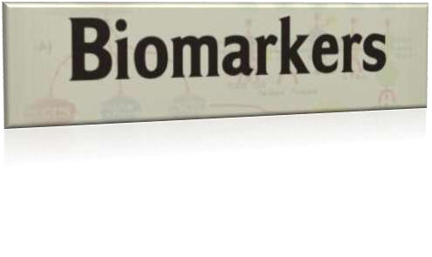
BIOMARKER
This type of Application of environmental Biotechnology gives response to a chemical that helps to measure the level of damage caused or the exposure of the toxic or the pollution effect caused. In other word, Biomarker can also be called as the Biological markers the major use of this applications helps to relate the connection between the oils and its sources.

Slide 9

A biomarkers is a change in biological responses ranging from molecular through cellular and physiological responses to behavioral changes which can be related to exposure to a toxic effected of environmental chemicals.
Recent development in molecular biology and biotechnology inventions led to development of more sensitive validate biomarkers of exposure effect and sensitivity to adverse effects to terrestrial and aquatic pollutions.

Slide 10

use of multiple biomarkers is also useful.
Biological assays —› in vivo biomarkers, in vivo bioassay and in vitro bioassay.
Biological assay (Bioassay) —› is a biological standardization type of scientific experiment.
A bioassay involves the use of live animal or plant (in vivo) or tissue or cell (in vitro) to determine the biological activity of a substance such as a hormone or drug.

Slide 11
Second approach using protein involve causing or modulating toxicity as biomarkers of
susceptibility.

Slide 12

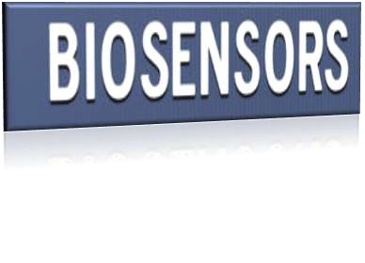
Biosensors are defined as analytical devices incorporating a biological material.
Biosensors are used for the sensitive biological
elements such as:
(e.g. tissue, microorganisms, organelles, cell receptors, enzymes, antibodies, nucleic acids, natural products).

Slide 13

Biosensors are reader device with the associated electronics or signal processors that are primarily responsible for the display of the results in a user-friendly way.
The known manufactures of biosensor electronic readers include Palmsens, Gwent Biotechnology systems and rapid Labs.

Slide 14

Current uses of biosensors include:
Detecting levels of toxins in an ecosystem.
Detecting airborne pathogens (i.e. anthrax).
Monitoring blood glucose levels.

Slide 15

One of the most common example of biosensor is Glucometer.
Glucometer —› Glucometer is a medical device for determining the approximate concentration of glucose in the blood.

Slide 16
Food analysis:
There are several applications of biosensors in food analysis.
In food industries optics coated with antibodies are commonly used to detect pathogens and food toxins. Commonly the light system in these biosensors in fluorescence, this type of optical measurement can greatly amplify the signal.

Slide 17
DNA Biosensors:
In the future DNA will find use as a versatile material from scientists can craft biosensors.
DNA biosensors can theoretically be used for medical diagnostics, forensic science, agriculture, or even environmental clean-up efforts.

Slide 18
DNA biosensors are complicated mini-machines → consisting of sensing elements, micro lasers, and a signal generator.
At the heart of DNA biosensor function is the fact that two strands DNA stick to each other by virtue of chemical attractive forces.

Slide 19
Microbial Biosensors:
Using biological engineering researchers have created many microbial biosensor.
E.g. Arsenic biosensor to detect arsenic they use the Ars operon.
using bacteria, researchers can detect pollutants in samples.

Slide 20


BIOFUEL
The use of this application of Environment Biotechnology is in the industrial, domestic and space sectors.
As per the recent need it is concluded that the need of clean energy out of these fuels and alternative ways of finding clean energy is the need of the hour.

Slide 21

Biofuels are fuels derived from biomass →any matter derived from plants or animals.
A fuel is nothing to more then something from which we get energy.

Slide 22
Biomass → biomass is simply organic matter.
In other words it is a dead material that was once living.
Kernels of corn, mats of algae, and stalks of sugar cane are all biomass.

Slide 23
1. 1st Generation Biofuels:
Bioalcohol (Corn, sugarcane)
Biodiesel
Syngas
Biogas
2. 2nd Generation Biofuels:
Cellulosic Biofuels
Biohydrogen
Bioethanol
3. 3rd Generation Biofules:
Algae fuel

Slide 24
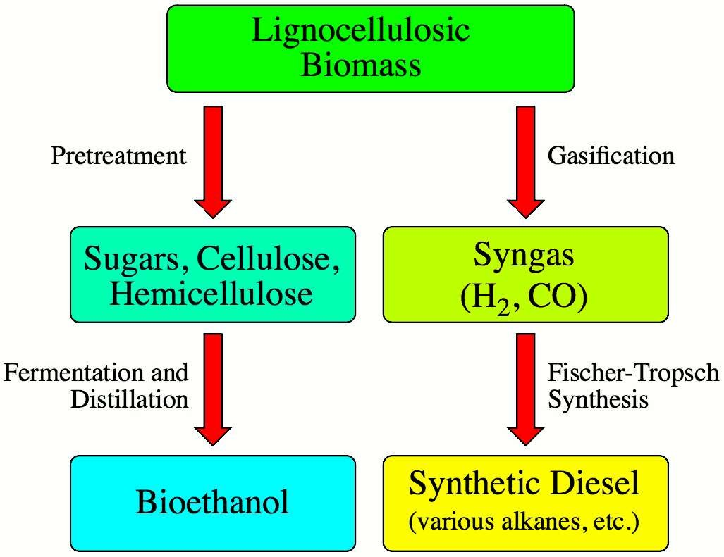

Slide 25


BIOREMEDIATION
Bioremediation →"Remediate" means to solve a problem, and "bio-remediate" means to use biological organisms to solve an environmental problem such as contaminated soil or groundwater.

Slide 26
The process of cleaning up the hazardous substances into non-toxic compounds is called the Bioremediation process.
This process is majorly used for any kind of technology clean up that uses the natural microorganisms.

Slide 27
Bioremediation works by providing these pollution- eating organisms with fertilizer, oxygen, and other conditions that encourage their rapid growth.
These organisms would then be able to break down the organic pollutant at a correspondingly faster rate. In fact, bioremediation is often used to help clean up oil spills.

Slide 28
Bioremediation of a contaminated site typically works in one of two ways.
In the 1st case described above, ways are found to enhance the growth of whatever pollution-eating microbes might already be living at the contaminated site.
In the second, less common case, specialized microbes are added to degrade the contaminants.

Slide 29
Bioremediation provides a technique for cleaning up pollution by enhancing the same biodegradation processes that occur in nature.
Bioremediation may be safer and less expensive than alternative solutions such as incineration or land-filling of the contaminated materials.

Slide 30

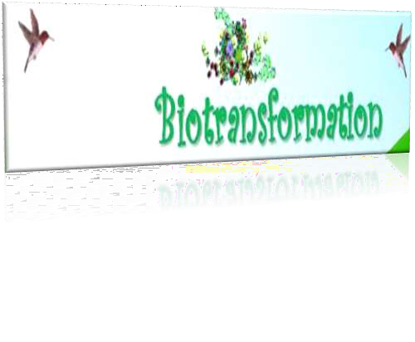
BIOTRANSFORMATION
The changes that take place in the biology of the environment which are changes of the complex compound to simple non-toxic to toxic or the other way round is called the biotransformation process.

Slide 31
It is used in the Manufacturing sector where toxic substances are converted to Bi-products.

Slide 32
The conversion of molecules from one form to another within an organism.
often associated with change
(increase, decrease, or little change) in pharmacologic activity refers especially
to drugs and other xenobiotics.

Slide 33


Molecular ecology is a field of evolutionary biology that is concerned with applying molecular population
genetics,molecular phylogenetics, and more recently genomics to traditional ecological questions.
(e.g., species diagnosis, conservation and assessment of biodiversity, species-area relationships, and many questions in behavioral ecology).

Slide 34

Using biological techniques (i.e. DNA fingerprinting) to better understand aspects of nature.
This is done to look at the biodiversity of different populations to ensure they are not at risk of going extinct (cheetahs and polar bears currently).

Slide 35
It can be used to determine if a new species has emerged and also better map the evolutionary development of different families of animals (horses and whales currently).

Slide 36





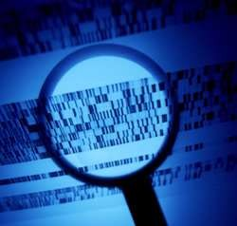
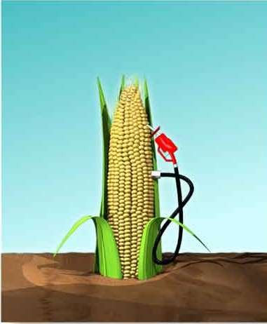
Reading a DNA fingerprint
Biofuel exaggeration

Slide 37

BENEFITS
The major benefits of environmental biotechnology are it helps to keep our environment safe and clean for the use of the future generations. It helps the organisms and the engineers to find useful ways of getting adapted to the changes in the environment and keep the environment clean and green.

Slide 38
THANK YOU

